Slide 1
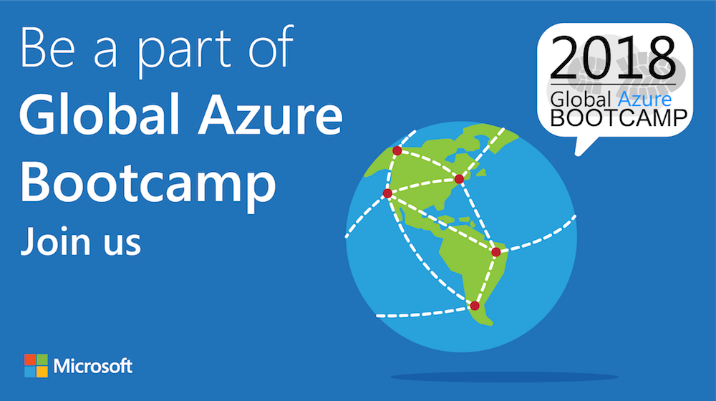

Slide 2

Welcome to the
{Curitiba - PR}

Slide 3

Sponsors & Prices

Slide 4








A BIG thank you to the 2018 Global Sponsors!

Slide 5


Another BIG thank you to local sponsors!

Slide 6


All attendees get the following:
Sponsor | Offering
Cloudmonix https://cloudmonix.com | Cloudmonix offers a $300 off any paid plan for Azure monitoring! http://bit.ly/gab2018-cloudmonix Code: GAB2018
MyGet https://myget.org | MyGet offers a free 1 month Starter Plan for hosting your NuGet, npm, Maven, Bower of VSIX feeds! http://bit.ly/gab2018-myget Code: GGAB2018-MG
ServiceBus360 https://servicebus360.com | Servicebus360 is offering 2 months free of their Gold Plan! http://bit.ly/gab2018-sb360
Cerebrata https://cerebrata.com | Cerebrata is providing a 3 month subscription to it’s Cerulean product! Get your subscription key from your organizer!
Offers valid until April 30th

Slide 7


Raffle Prizes
1 Winner: a 1 year personal subscription of the All Products Pack. Get all desktop products including IntelliJ IDEA Ultimate, ReSharper Ultimate and other IDEs
1 Winner: a 1 year subscription to Cerulean! A cross-platform Azure management tool for storage, CosmosDB, Search, Redis Cache and Service Bus.
1 Winner: a 1 year subscription to their online training, Skill Me Up! Online training to continue your Azure journey.
Raffle winners will receive a voucher with a code from the local organizers.

Slide 8



Título: Ruby on Rails & Azure
Jorge Madson
Ruby on Rails & Azure
Curitiba

Slide 9
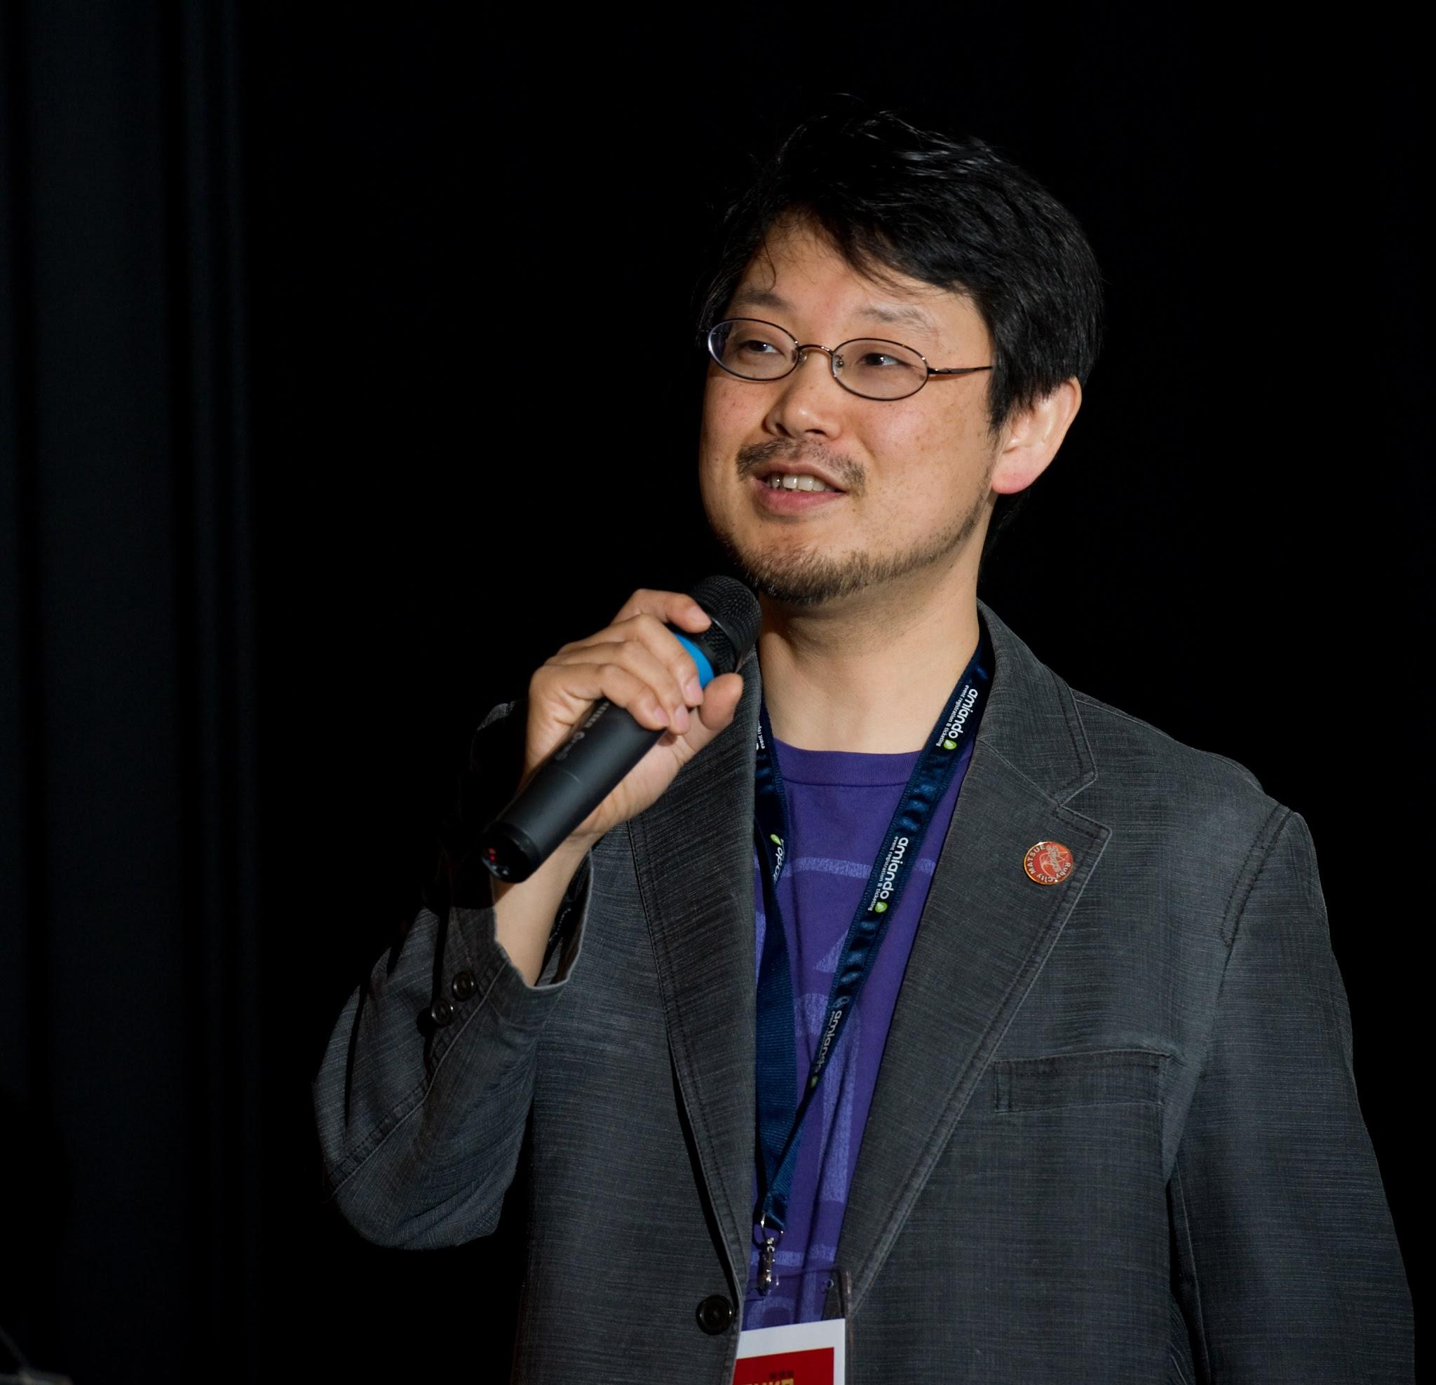
1. O que é Ruby on Rails
Criador: Yukihiro Matsumoto -> 1995

Slide 10

1. O que é Rails
Criador: David Heinemeier Hansson [Basecamp] -> 2003

Slide 11
Aprendendo Ruby (e Rails!)
Ruby: http://tryruby.org Rails:
http://railsforzombies.org/

Slide 12

3. Criando o primeiro app

Slide 13
Mas antes!
Como instalar:
Linux: https://gorails.com/setup/ubuntu/16.04 Windows:
http://railsinstaller.org/en

Slide 14

4. Subindo no Azure
A apresentação foi baseada nesse tutorial: https://docs.microsoft.com/pt-br/azure/app-service/containers/tutorial-ruby-mysql-app

Slide 15
Global Footprint

Slide 16
pay only for what you use
→

Slide 17

Virtual Machines
Windows Server and Linux Virtual Machines
Flexible Workload Support
Virtual Private Networking

Slide 18
Demo + Hands-On

Slide 19
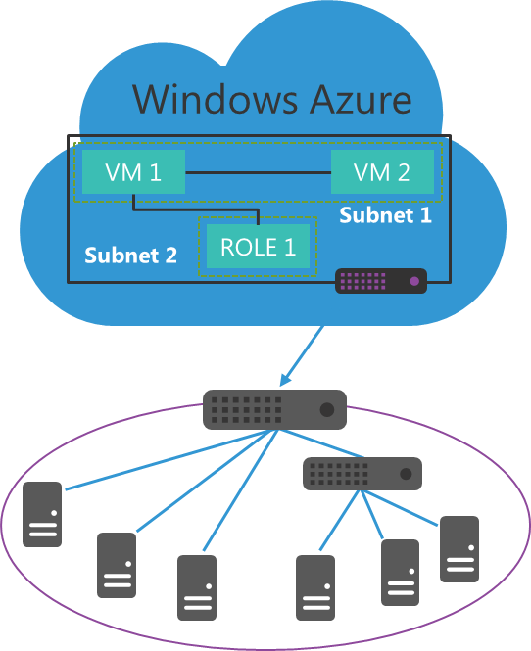
Windows Azure Virtual Networks
Build virtual networks that scale
Traditional, familiar approach to build extension to datacenter
Scalable approach to building virtual networks
Control over network configuration
Define your own IP address ranges
Be compliant with corporate IT security policy
Enables rich hybrid scenarios
Hybrid apps can reach all or portion of the on-premise network
Works with both Windows and non-Windows systems
Corpnet

Slide 20






Virtual Gateways
Contoso Production VNet in Windows Azure (10.1.0.0/16)
Point-to-Site
VPNs
Contoso HQ (10.0.0.0/16)
10.1.2.0/24
10.1.3.0/24
SQL Farm
IIS Servers
131.57.23.120
S2S VPN tunnel
65.52.249.22
10.1.0.4
10.1.1.4
10.0.0.10
10.0.0.11
Contoso Test in Windows Azure (10.2.0.0/16)
AD / DNS
S2S VPN Device
S2S VPN tunnel
Exchange
BRK Gateway
10.2.2.0/24
10.2.3.0/24
Point-to-Site
VPNs

Slide 21




MSDN Credits with Windows Azure
$50
per month
for Visual Studio Professional
$100
3 VMs for 16 hours a day
per month
for Visual Studio Premium
$150
per month
Up to 500 web sites plus SQL DB
for Visual Studio Ultimate

Slide 22
focus on apps, not infrastructure

Slide 23

SQL Database
Relational SQL Server Engine in the Cloud
Clustered for high availability
Fully Managed Service

Slide 24
Dev/Ops Workflow
Develop
Repeatable
Reliable
Predictable
Low Cycle Time
Learn
Deploy
Operate

Slide 25

Storage
Highly scalable, durable, available storage system
Blobs can be exposed over http (JSON + CORS)
Optionally enable client apps short term access
Import / Export Service with Physical Drives

Slide 26

Active Directory
Active Directory in the Cloud
Integrate with on-premises Active Directory
Enable single sign-on within your apps
Supports SAML, WS-Fed, and OAuth 2.0

Slide 27

3rd party apps
Windows Azure
Your app in Azure
Windows Azure Active Directory
Windows Server Active Directory

Slide 28

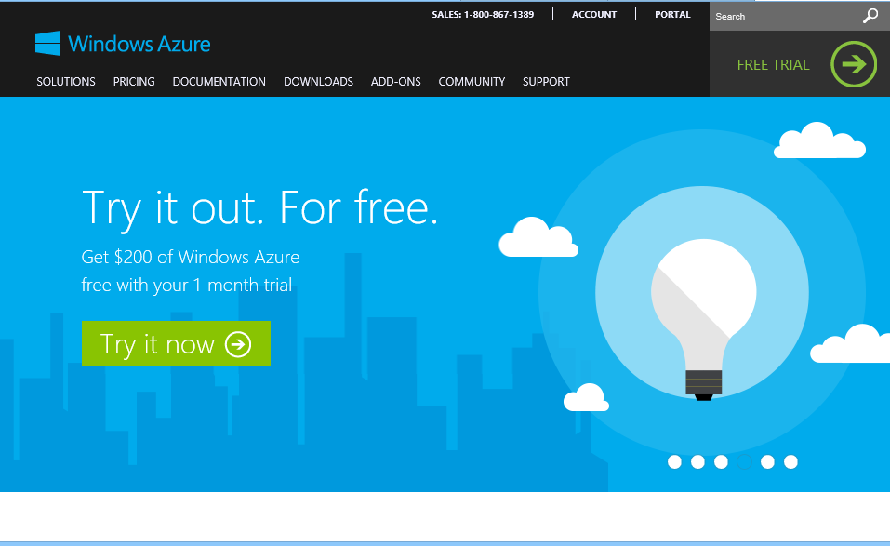
Comece agora.
http://WindowsAzure.com

Slide 29
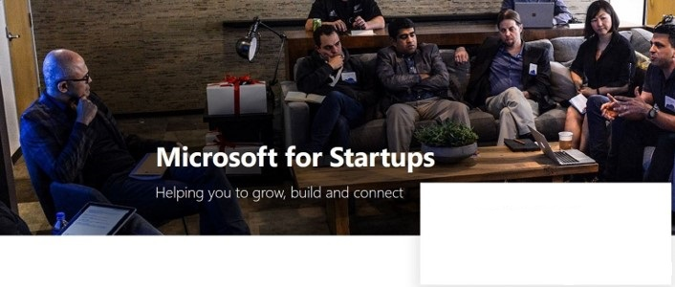

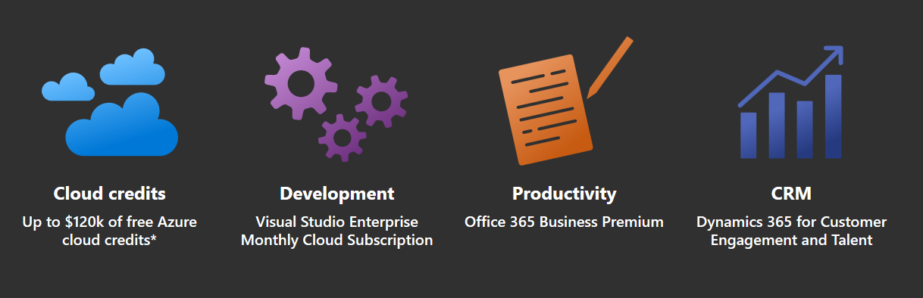
Microsoft 4 Startups
https://startups.microsoft.com
Notes:
Microsoft for Startup é o substituto do antigo “Microsoft BizSpark”.

